Slide 1
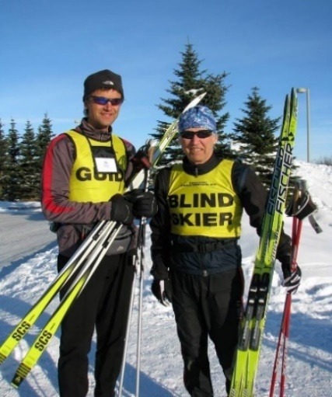
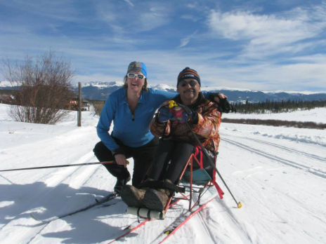
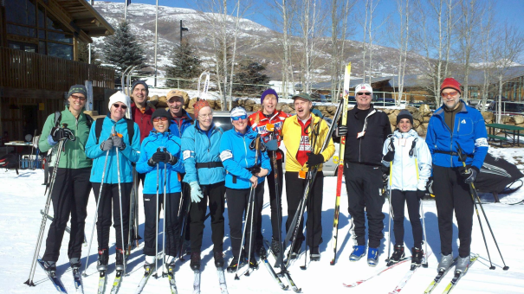
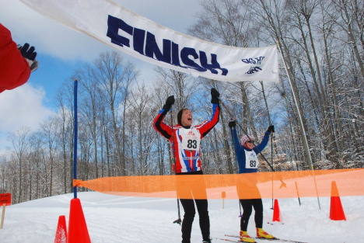
Get involved with SFL!
Skiing. Sharing. Learning.
The mission of Ski for Light (SFL) is to enhance the quality of life and independence
of visually or mobility-impaired adults through a program of cross-country skiing.
Join us at our annual week long XC Ski Event: SFL International!
As a blind, visually or mobility impaired skier
Beginners thru advanced skiers are welcome!
Trained guides ski alongside skiers
As a XC Ski Guide
Share the sport you love with adaptive skiers.
Intermediate or advanced skiers welcome.
SFL provides training.
As a Worker Bee
Volunteer to assist the ~200+ skiers
Support SFL!
Make a financial contribution (tax deductible)
Sponsor SFL by donating goods or services
Be a SFL ambassador: spread the word about
SFL to potential skiers, guides, volunteers & sponsors
Ski locally and help a future SFL skier prepare!
www.sfl.org www.facebook.com/skiforlight

